Slide 1


Slide 2
Review of the Literature
Chapter 2

Slide 3
Introduction
Topic – subject or subject matter of a study
  e.g., “faculty teaching,” “organizational creativity,” “psychological stress”
Conduct literature review about the topic
  Worth studying?
  Scope?
  Can be studied

Slide 4
The Research Topic
Gain insight into the topic by
    Drafting a working title
      “My study is about…”
    Posing a brief question
      What needs to be answered?

Slide 5
The Research Topic
First step is to examine research on the topic
How does this project contribute to the literature?
New topic, new elements, replication with new participants?

Slide 6
The Research Topic
The topic can be researched if
  You have access to participants
  You have resources to collect and analyze information
The topic should be researched if
  The research will add to the literature about the topic
  Scholars will be interested in the topic
  A study of it will advance your personal goals

Slide 7
The Literature Review
Shares the results of other studies
Relates the study to the larger dialogue in the literature
Provides a framework for establishing the importance of the study
Provides a benchmark for comparing the results to other findings

Slide 8
The Literature Review
The use of the literature:
Seek opinion of adviser or faculty members
Tell the reader you are aware of literature
Literature reviews take several forms:
  Integrate what others have done and said
  Criticize previous scholarly works
  Bridge between related topics
  Identify the central issues in the field

Slide 9
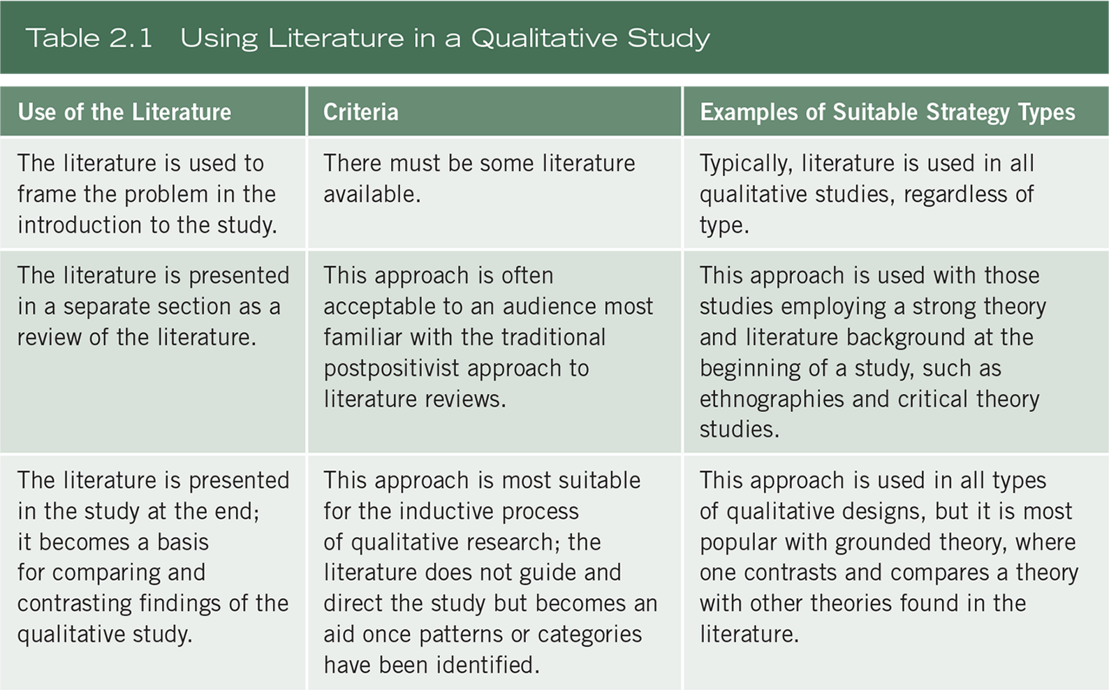
The Literature Review

Slide 10
The Literature Review
The use of the literature:
In quantitative studies, researchers use literature to:
  Provide direction to the research questions and hypotheses
  Introduce a problem
  Introduce and describe the theory that will be used
  Examine the usefulness of the theory
  Compare results with existing literature or predictions
Notes:
In qualitative research, inquirers use the literature in a manner consistent with the assumptions of learning from the participant, not prescribing the questions that need to be answered from the researcher’s standpoint. One of the chief reasons for conducting a qualitative study is that the study is exploratory. This usually means that not much has been written about the topic or the population being studied, and the researcher seeks to listen to participants and build an understanding based on what is heard.
The use of literature in qualitative research varies considerably. In one example, literature on a cultural concept or a critical theory can be introduced early as an orienting framework for ethnographies.

Slide 11
The Literature Review
The use of the literature:
In mixed methods studies, researchers use the literature:
  In either a quantitative or qualitative approach
  In each phase, consistent with either the quantitative or qualitative approach
  Relative to the intended audience

Slide 12
The Literature Review
Steps in conducting a literature review:
Identify key words
Search databases
Identify about 50 research reports in articles or books
Collect those that are central to your topic
Design a literature map
Draft summaries of relevant articles
Write a literature review, organizing it by important concepts

Slide 13
The Literature Review
Searching computerized databases:
Computerized databases of the literature are available the Internet
Databases provide access to journal articles, conference papers and dissertations on a wealth of topics

Slide 14
The Literature Review
Searching computerized databases:
Some of these online databases include:
ERIC - ProQuest - EBSCO
Sociological Abstracts - PsycINFO - PubMed
Science Direct - Google scholar - SSCI

Slide 15
The Literature Review
Searching computerized databases:
Use both free databases and those available in your academic library
Search several databases, even those outside your field
Use guides to terms to locate articles
Locate articles close to your topic and use their terms in your search
Use databases that provide access to full text

Slide 16
The Literature Review
A priority for selecting literature material:
Start with broad syntheses (such as encyclopedias) if you are new to the topic
Turn to journal articles in national journals
  Best source for research reports
Next, consider books
Then examine conference papers
Scan for dissertations
Lastly, consider reports on the web

Slide 17
The Literature Review
A literature map of the research
A literature map is a visual summary of existing research on a topic
The structure of the literature map may be:
  Hierarchical pattern
  Flowchart layout
  Series of circles
Write a narrative description

Slide 18
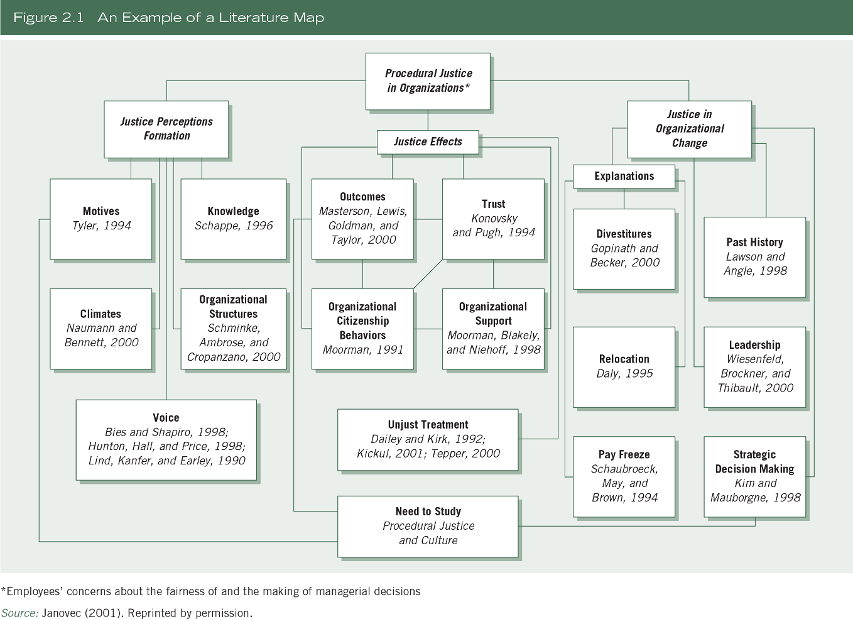
The Literature Review

Slide 19
The Literature Review
Abstracting studies:
Abstracts summarize major elements of the article
For research studies:
  Mention the problem
  State the central purpose
  State information about the population and sample
  Review key results
  Point out methodological flaws (if a critique or methods review)

Slide 20
The Literature Review
Abstracting studies:
For nonempirical studies (essays, opinions, etc.)
  Mention the problem
  Identify the central theme
  State the major conclusions
  Mention flaws in reasoning or logic (if a methodological review)

Slide 21
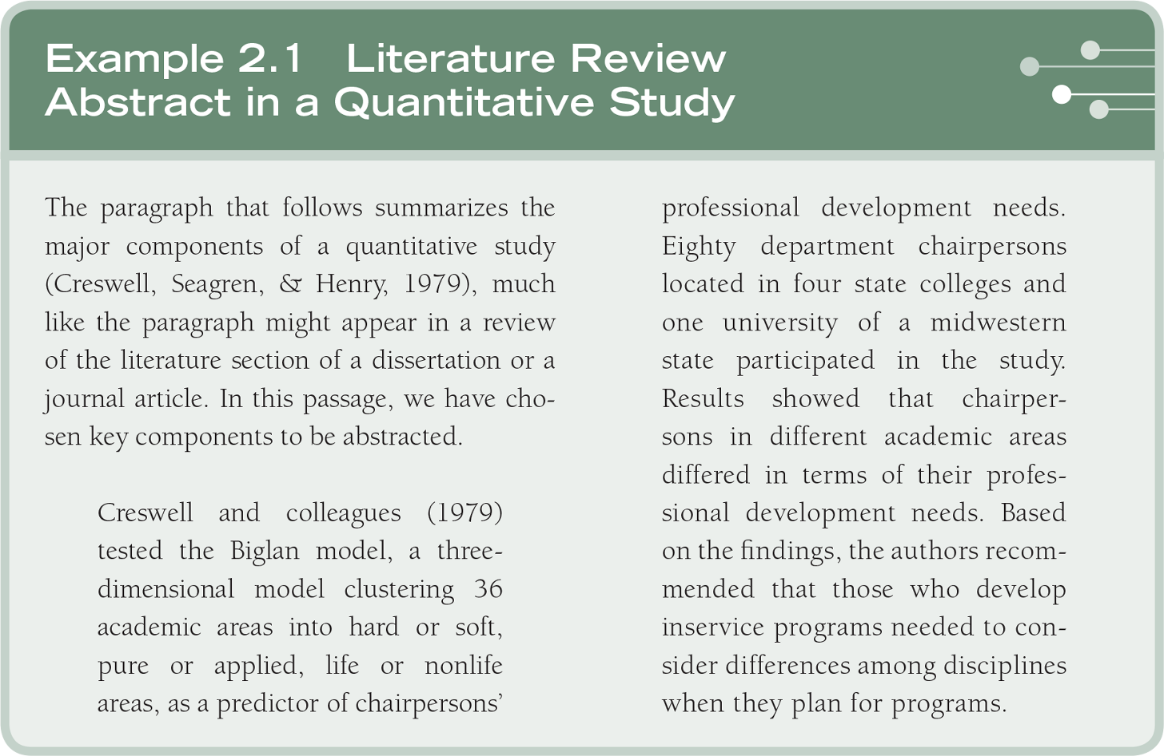
The Literature Review

Slide 22
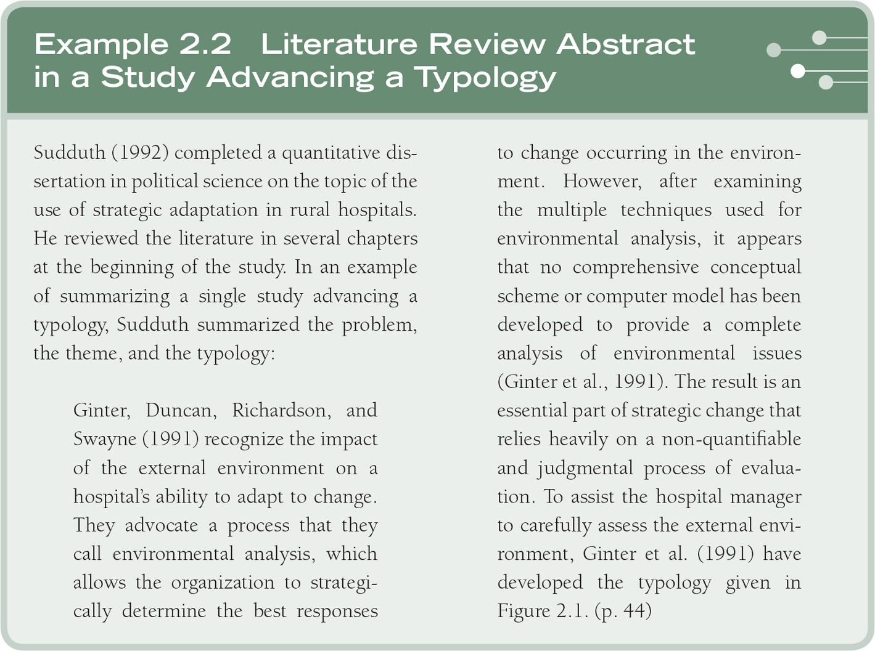
The Literature Review

Slide 23
The Literature Review
Style manuals:
Style manuals provide guidelines for producing scholarly work and include directions on:
  Citing references in-text
  End-of-text references
  Creating headings
  Footnotes (not used in all style manuals)
  Presenting tables and figures
Reminder: Consistently use the chosen style manual

Slide 24
The Literature Review
Definition of terms
Identify and define terms that readers need to understand a proposal
Define terms introduced in all sections of the research plan:
  Title of the study
  Problem statement
  Purpose statement
  Research questions, hypotheses, or objectives
  Literature review
  Theory base of the study
  Methods section

Slide 25
The Literature Review
Definition of terms
Qualitative studies
  Inductive and evolutionary in nature
  The definition of terms may appear later in the written report, perhaps in the data analysis
Quantitative studies
  Deductive with a fixed set of objectives
  All relevant terms are comprehensively defined earlier in the study

Slide 26
The Literature Review
Definition of terms
Mixed methods studies
  Follows the use of quantitative or qualitative approach
  Clarify terms related to mixed methods

Slide 27
The Literature Review
Definition of terms
Define terms when they first appear in the manuscript
Use specific operational definitions
Do not define terms using everyday language, be guided by the literature
Define terms so that they accomplish different goals
One may use a definition of terms section in the manuscript

Slide 28
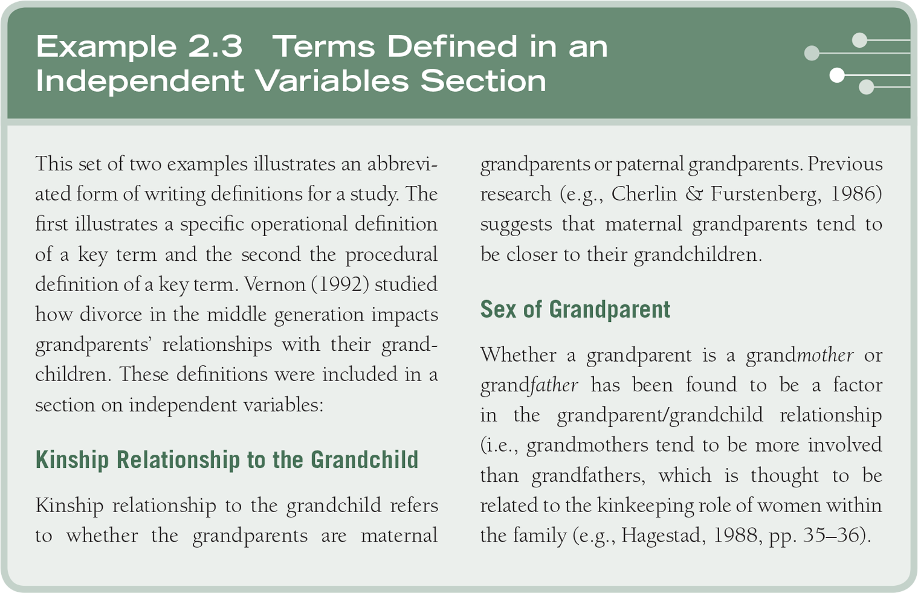
The Literature Review

Slide 29
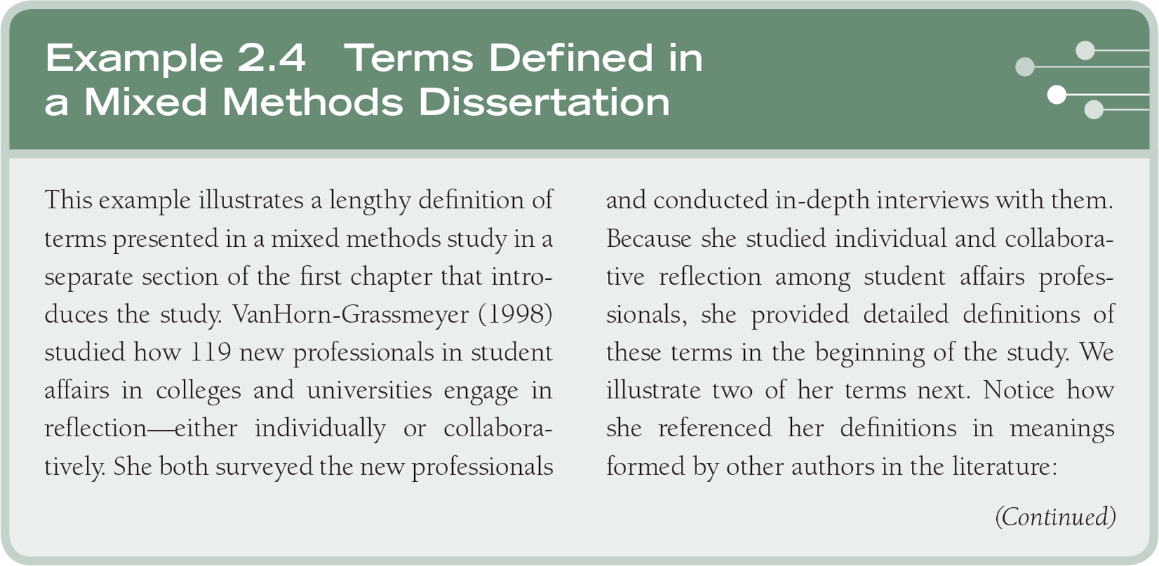
The Literature Review

Slide 30
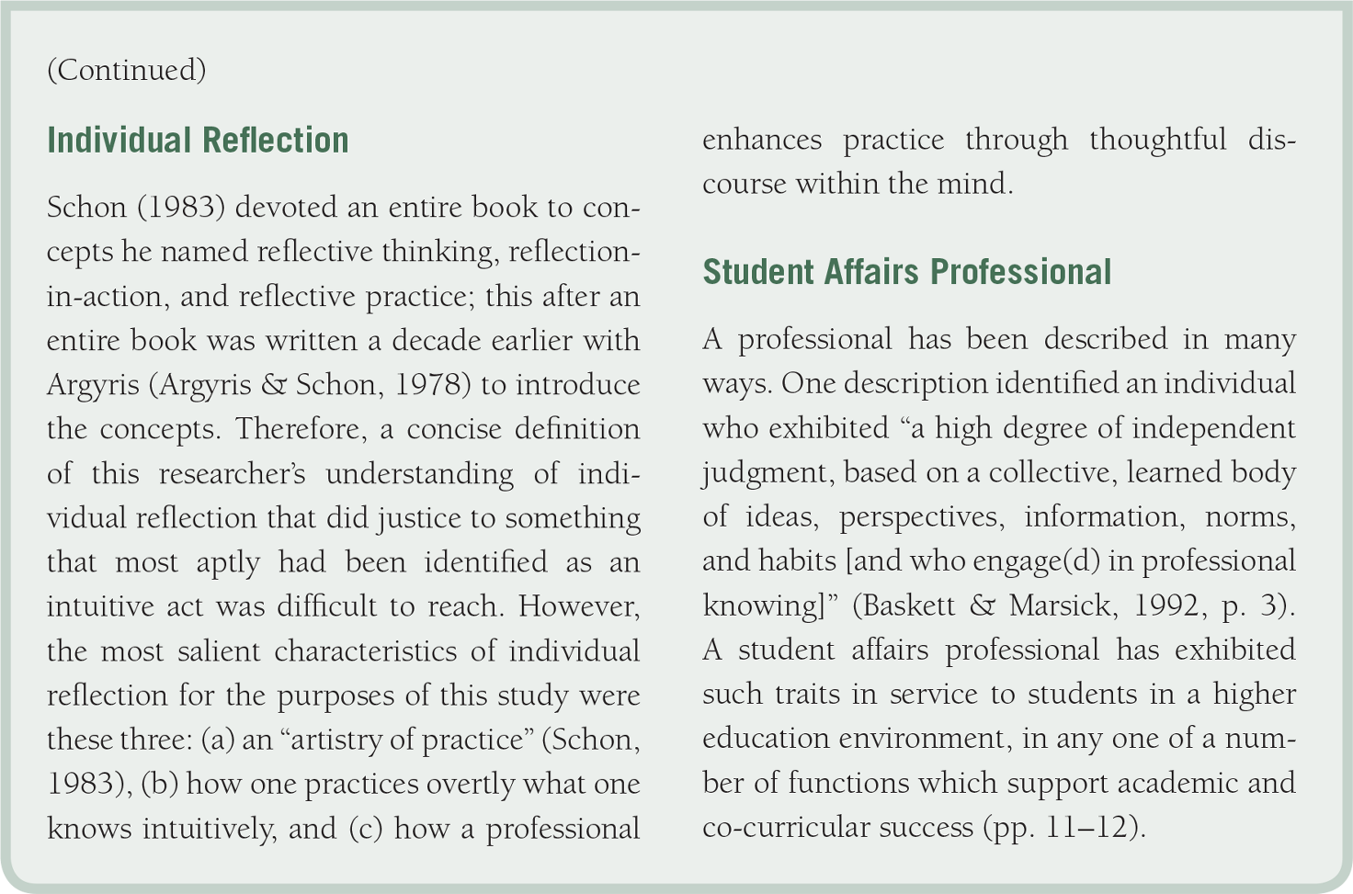
The Literature Review

Slide 31
The Literature Review
A quantitative or mixed methods literature review:
Introduce the review with a statement about the organization of the sections
Review literature about the independent variables
Review literature about the dependent variables
Review literature that relates the independent variables to the dependent variables

Slide 32
The Literature Review
A quantitative or mixed methods literature review:
Provide a summary
  Highlight important studies
  Capture major themes
  Suggest why more research is needed
  Advance how the proposed study will fill this need

Slide 33
Summary
Identify your topic through a brief title or central research question
Use the literature to
  Present similar studies
  Relate the study to the literature
  Provide a framework for comparison
Different purpose depending on approach
Search databases using key terms

